Slide 1
4.1 Effects Operations Overview
Notes:
# 4.1 Effects Operations Overview — Content Guide
**Source:** `../Week 4 Overview.md`, `../labs/L4.1a_Disable_Adversary_Tooling/`, `../labs/L4.1b_False_Information_Injection/`
**Audience:** CPT operators who have completed Weeks 1-3 and already hold staged access to the adversary stack.
**Duration:** ~75 minutes (opening block of Day 1, Week 4)
**Prerequisites:** Week 1 (METT-TC, CG/CV, EMLCOA, actions-on-contact), Week 2 (access tradecraft), Week 3 (on-target enumeration discipline).
**References:**
- `../../week1/content-guides/1. Tactical Planning Part 1 Content Guide.md` (CG/CV vocabulary)
- `../../week1/content-guides/5. MITRE ENGAGE Content Guide.md` and `../../week1/5. MITRE ENGAGE.md`
- `../../week1/4. MITRE D3FEND CAD.md`
- `../lab_env/README.md` (adversary stack layout)
---

Slide 2
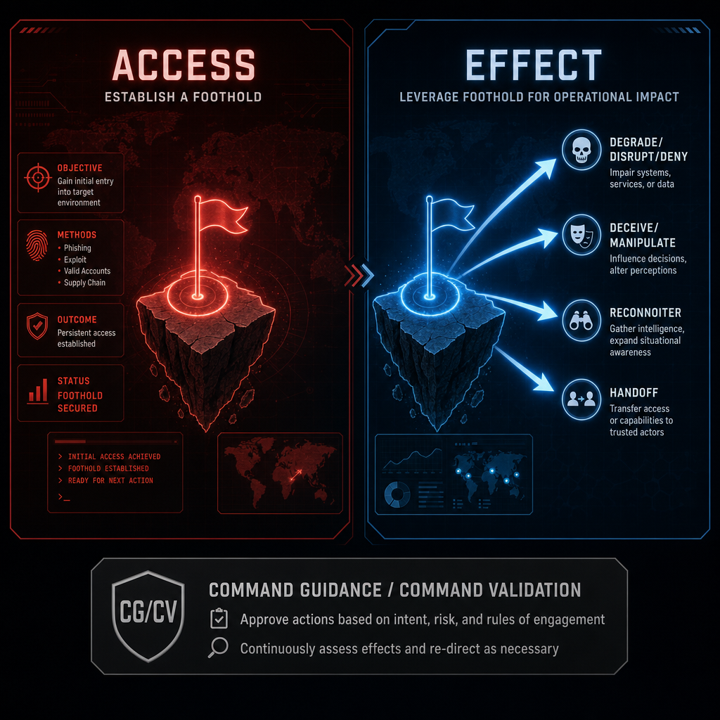
Effects Operations — Why We Are Here
Week 3: inside the adversary stack
Access enables action
Effects create mission value
Week 1 still drives choices: CG / CV / exploitation plan
Notes:
Say:
"Week 3 got you inside the adversary stack."
"That was the price of admission."
"Week 4 asks the next question: now that you are there, what do you do?"
"Access matters when it produces a deliberate, bounded effect."
"Every effect still has to support the Week 1 CG/CV logic."
"First two days: deliberate effects."
"Last three days: doing this with AI help, and recognizing adversary AI use."
Show:
Point from "Access" to "Effect."
Point at the CG/CV callout.
Do:
Ask: "From Week 1, what is the center of gravity of the APT we studied?"
Take one answer.
Ask: "And what is a critical vulnerability against that CG?"
Capture both on the whiteboard as the running example.
Image Prompt:
A split-screen graphic. Left panel: a stylized red-team dashboard labeled "Access" with a glowing foothold icon. Right panel: the same foothold now labeled "Effect" with four outbound arrows labeled Degrade/Disrupt/Deny, Deceive/Manipulate, Reconnoiter, Handoff. A dim CG/CV callout box underneath both panels.

Slide 3
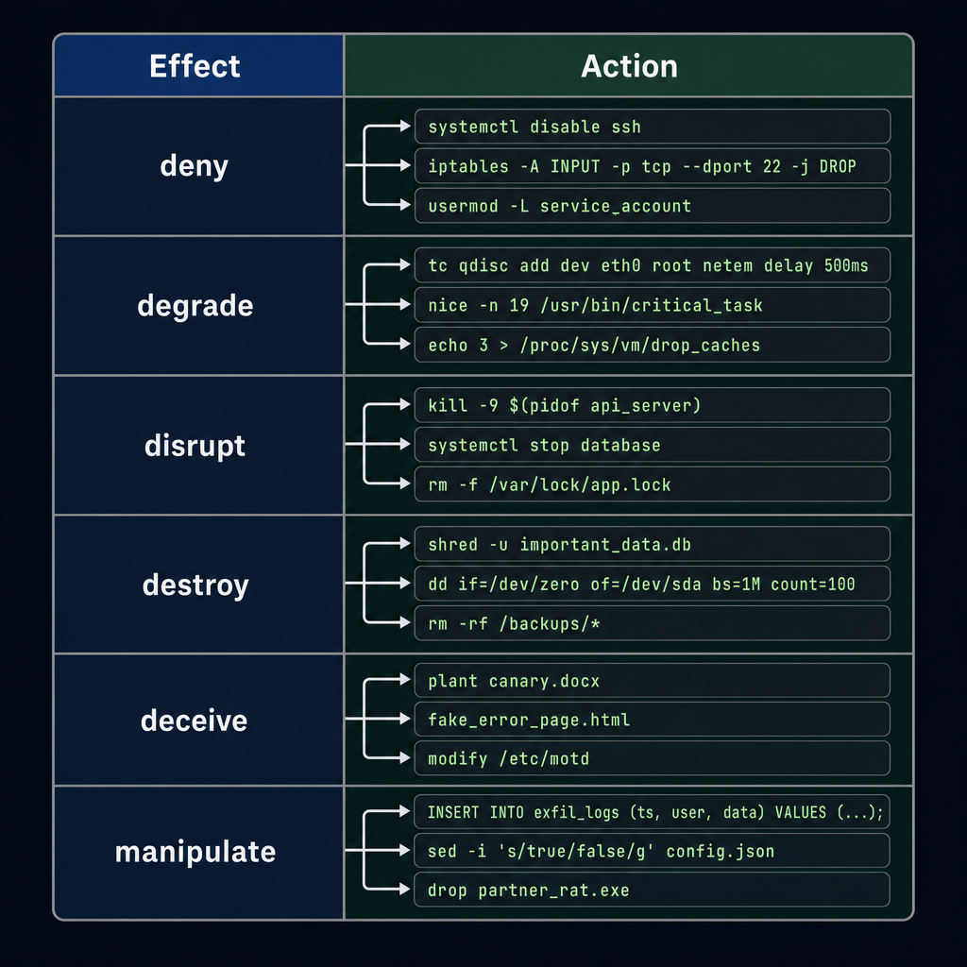
Effect ≠ Action
Effect: intended adversary change
Action: technical method
Same effect, many actions
Same action, many effects
Commanders task effects; operators choose actions
Notes:
Say:
"Effect versus action keeps you out of trouble."
"Commander says: degrade their collection."
"That is an effect."
"You choose the action: stop a service, poison a database, corrupt logs."
"Choice depends on assessment, risk, access reliability, team skill, and partner need."
"Do not report an effect you did not actually achieve."
Show:
Point to the effect column.
Point to the action column.
Linger on the multi-to-multi arrows.
Do:
Ask: "Name an action you took in a Week 3 lab."
Ask: "What effect, if any, did it produce?"
Take two answers.
Correct effect/action conflation.
Image Prompt:
A two-column table graphic. Left column "Effect" (verbs: deny, degrade, disrupt, destroy, deceive, manipulate). Right column "Action" (specific tool/command examples: `systemctl disable`, `INSERT INTO exfil_logs ...`, `plant canary.docx`, `drop partner_rat.exe`). Arrows show that multiple actions can map to the same effect.

Slide 4
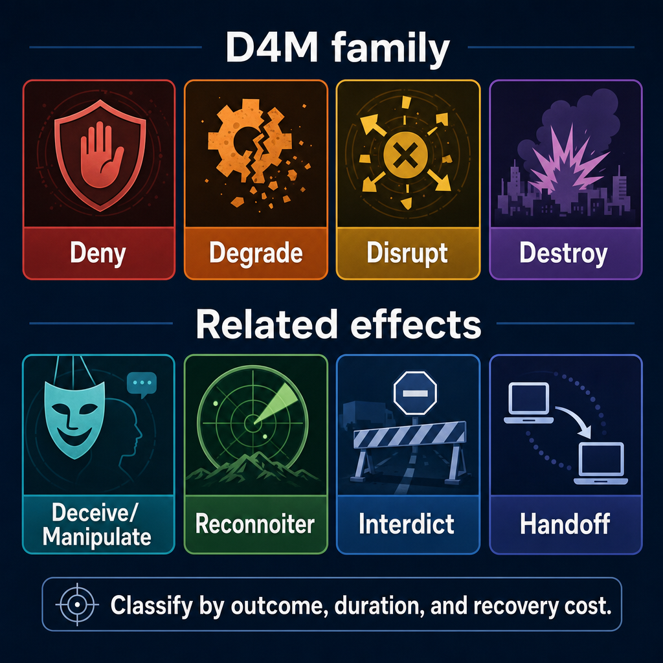
Doctrinal Effects Language (D4M Family + Related Terms)
D4M: deny / degrade / disrupt / destroy
Related: deceive / manipulate / reconnoiter / interdict / handoff
Next: example-driven outcomes
Classify by outcome, duration, recovery cost
Notes:
Say:
"This is Week 1 language, not a new dictionary."
"D4M verbs describe what you want done to an adversary capability."
"Related terms cover decision-cycle attack, intelligence collection, pathway denial, and partner transition."
"Classification is not the command you typed."
"Classification is what changed, how long it lasts, and how hard recovery is."
"The next slides stay concrete and example-driven."
Show:
Walk the D4M row left to right.
Walk the related-effects row left to right.
Point at the footer classification line.
Do:
Tell students: "For every example, ask what the adversary lost, kept, missed, or misunderstood."
Tell students: "Also ask what you must check before touching the keyboard."
Image Prompt:
A two-row graphic. Top row labeled "D4M family" with four tiles: Deny, Degrade, Disrupt, Destroy. Bottom row labeled "Related effects" with four tiles: Deceive/Manipulate, Reconnoiter, Interdict, Handoff. Add a footer line: "Classify by outcome, duration, and recovery cost."

Slide 5
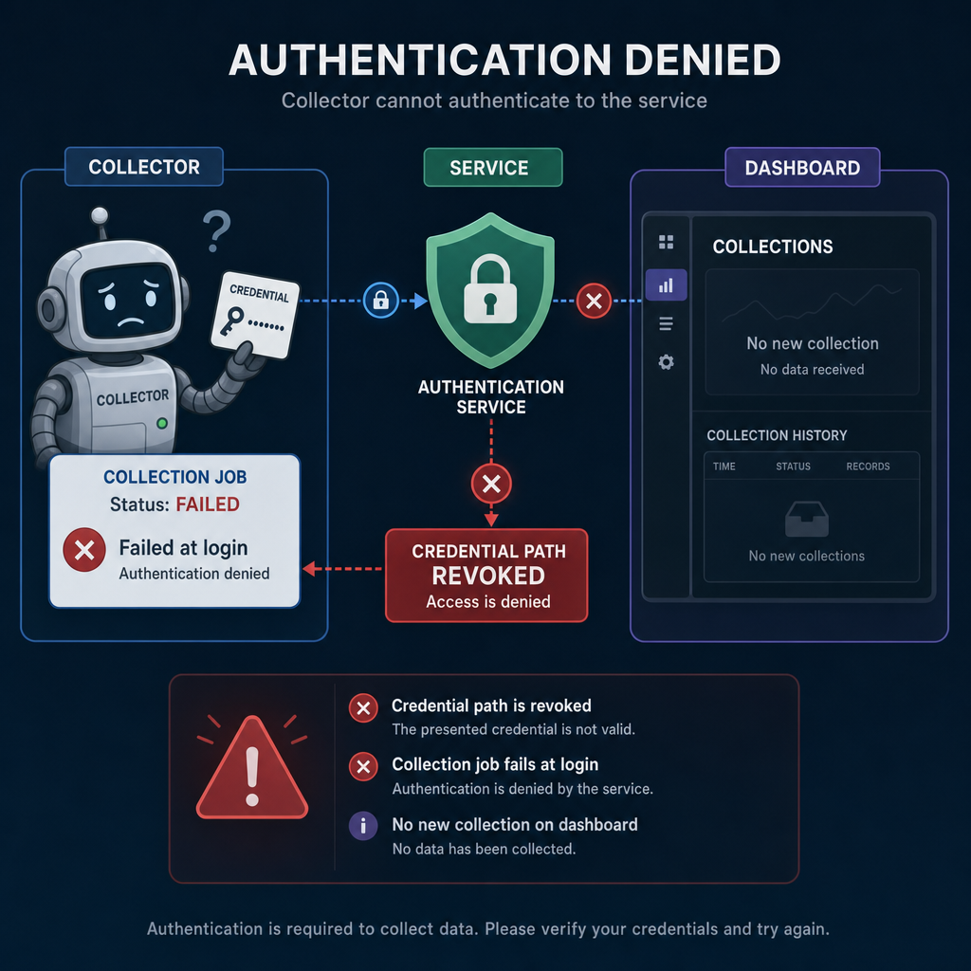
Deny Example — Revoke the Collector Credential
Outcome: collector cannot authenticate
Example: revoke the collector credential
Access: can we reach the identity/control plane reliably?
Dependency: is this the credential the workflow actually uses?
Alternates: backup token, service account, cached secret?
Rollback: who restores it, and how fast?
Proof: auth failure plus stopped collection
Notes:
Say:
"Deny is a hard stop."
"The adversary still wants to run the capability, but cannot."
"Scenario: the collector polls a staging API with one service credential."
"That credential is the dependency that lets collection run."
"Action: disable, revoke, or rotate that credential so the collector cannot log in."
"Do not assume the credential matters; prove the workflow uses it."
"Check for alternate credentials before calling this denial."
"Evidence should show authentication failure and stopped collection."
"If a backup token keeps the workflow alive, you did not deny it."
Show:
Point to the revoked credential.
Point to the failed login.
Point to the missing downstream collection.
Do:
Ask: "What would prove this credential is the real dependency?"
Ask: "What alternate path would defeat this denial?"
Image Prompt:
A denial graphic showing a collector trying to authenticate to a service. The credential path is marked revoked, the collection job fails at login, and the downstream dashboard shows no new collection.

Slide 6
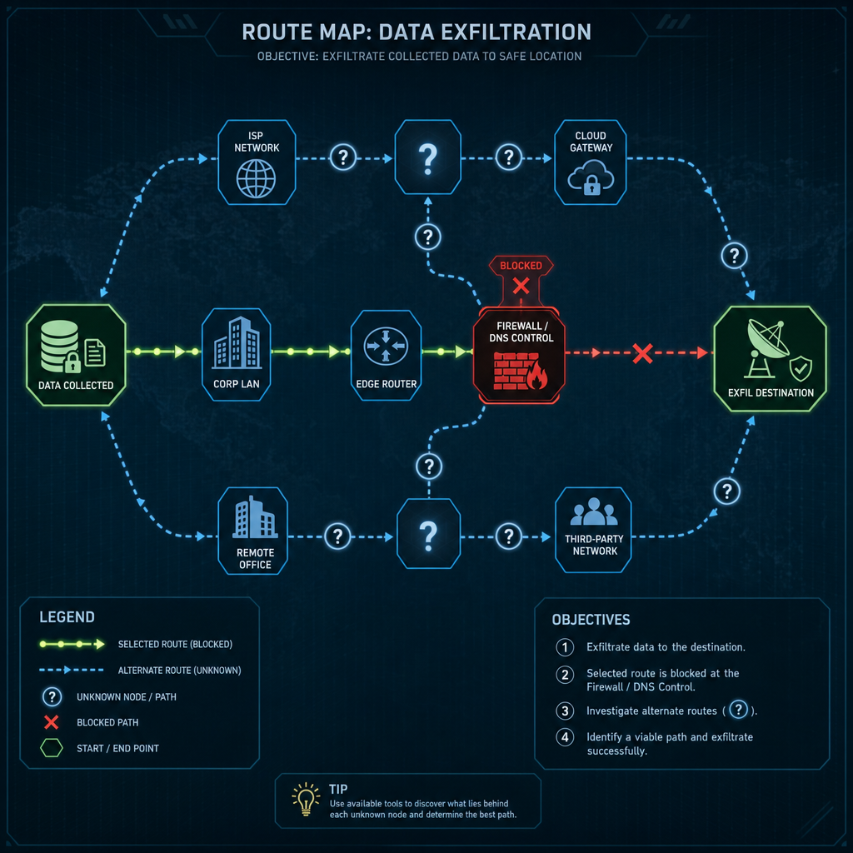
Deny Example — Block the Exfil Route
Outcome: data cannot leave by that path
Example: block the exfil route
Access: can we change the right DNS/firewall/route point?
Path: destination, port, protocol, relay sequence?
Alternates: fallback route, second relay, direct cloud path?
Persistence: survives restart and mission window?
Proof: failed connection plus stalled transfer
Notes:
Say:
"This is still deny because the selected path becomes unusable."
"The target is network reachability, not the local tool."
"Scenario: collection bundles leave through a relay path to a known reporting destination."
"That path depends on a DNS, firewall, proxy, or route control point."
"Action: block or sinkhole the selected route so bundles cannot reach the destination."
"Students must identify the actual route before changing controls."
"Check for fallbacks, second relays, or direct cloud paths."
"Rule persistence matters if the mission window spans restarts."
"Evidence should show connection failure and no successful transfer."
"If traffic simply moves to another path, denial failed."
Show:
Trace the normal route.
Point to the block point.
Point to alternate-route checks.
Do:
Ask: "What makes this route the right control point?"
Ask: "What evidence separates route denial from a local tool crash?"
Image Prompt:
A route map showing collected data moving toward an exfil destination. The selected route is blocked at a firewall or DNS control point, with alternate routes shown as question-mark paths that students must check.

Slide 7
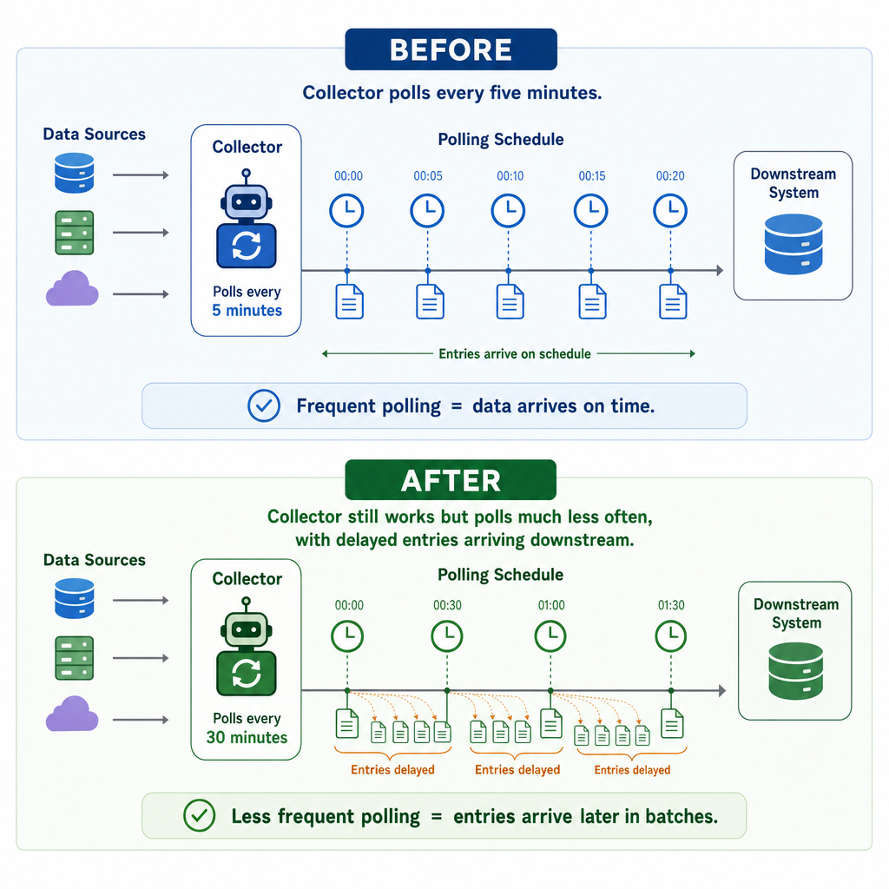
Degrade Example — Lengthen Polling Interval
Outcome: collection arrives too slowly
Example: lengthen polling interval
Access: can we edit config and reload safely?
Timing: what collection delay supports the mission?
Technique: reload, restart, or scheduled pickup?
Reversibility: known original value and restore path?
Proof: before/after cadence comparison
Notes:
Say:
"Degrade keeps the capability alive but worse."
"Here, the product is less timely."
"Scenario: a collector polls endpoints on a short interval and forwards results downstream."
"The adversary still gets data because the pipeline remains alive."
"Action: change the polling schedule so collection happens much less often."
"Do not pick an interval at random."
"Tie the delay to the mission window."
"Know whether the config needs reload or restart."
"Preserve the original value for rollback."
"Evidence is a before/after cadence comparison."
Show:
Compare normal cadence to delayed cadence.
Point out that collection still occurs.
Do:
Ask: "When does slow become operationally useful?"
Ask: "When would this accidentally become deny?"
Image Prompt:
A before/after timing graphic. Before: collector polls every five minutes. After: collector still works but polls much less often, with delayed entries arriving downstream.

Slide 8
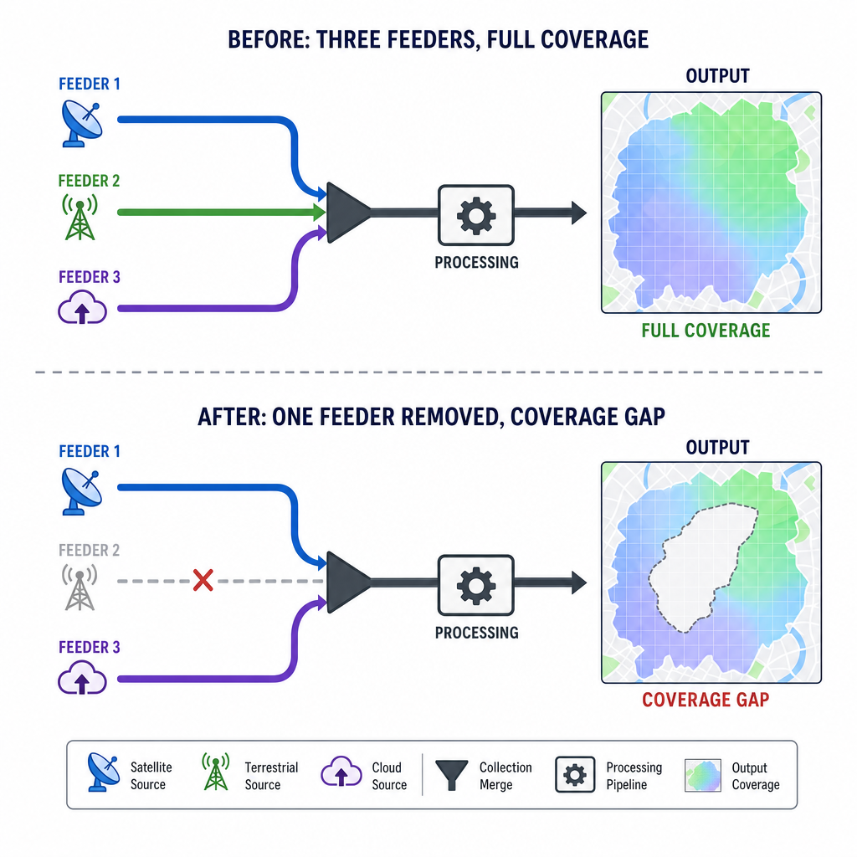
Degrade Example — Remove One Feeder Source
Outcome: coverage becomes incomplete
Example: remove one feeder source
Access: can we change the source without breaking the pipeline?
Dependency: what does this feeder uniquely provide?
Blast radius: partial loss, not total outage?
Visibility: will analysts notice and compensate?
Proof: lower volume or missing coverage area
Notes:
Say:
"This degradation reduces coverage rather than timing."
"The pipeline still runs."
"The product is less complete."
"Scenario: a redirector receives feeds from multiple implants."
"Those feeds are consolidated, parsed, and forwarded to a backend database."
"Action: remove or disable one feeder source while leaving the rest of the pipeline intact."
"Students must know what the feeder uniquely contributes."
"The goal is partial loss, not total outage."
"Analyst visibility matters; obvious loss may trigger fast repair."
"Evidence is lower volume or a missing coverage slice."
Show:
Point to the removed feeder.
Point to the remaining pipeline.
Point to the output gap.
Do:
Ask: "What would make this too obvious?"
Ask: "What evidence proves degradation instead of denial?"
Image Prompt:
A collection pipeline with three feeder sources entering one processing path. One feeder is removed, and the output still exists but has a visible coverage gap.

Slide 9
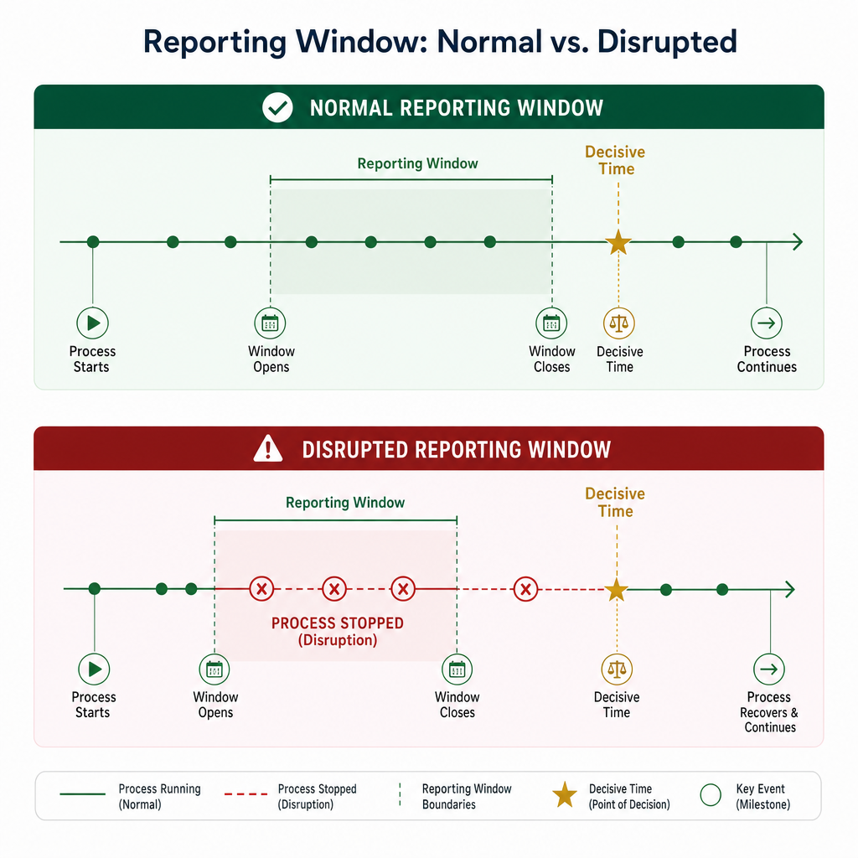
Disrupt Example — Stop Process During Reporting
Outcome: decisive reporting window missed
Example: stop process during reporting
Access: reliable at the exact action time?
Window: start, duration, and mission relevance?
Recovery: auto-restart, manual restart, or watchdog?
Coordination: team ready to observe and deconflict?
Proof: missed window plus later recovery
Notes:
Say:
"Disrupt breaks rhythm."
"The capability may come back."
"The problem is that it comes back too late."
"Scenario: a collection process has one reporting window that matters to the mission."
"If that window is missed, later recovery does not undo the disruption."
"Action: stop the process during the reporting window and allow recovery afterward."
"Timing is the center of this example."
"Students need the real reporting window, not a guess."
"Watchdog or auto-restart behavior changes the effect."
"Evidence is the missed window plus later recovery."
Show:
Point to the reporting window.
Point to the outage inside the window.
Point to recovery after the window.
Do:
Ask: "If it restarts after ten minutes but the window was five, what effect is that?"
Ask: "What evidence would you capture?"
Image Prompt:
A timeline with a normal reporting window on top and a disrupted window below. The process stops during the reporting period, then recovers later after the decisive time has passed.

Slide 10
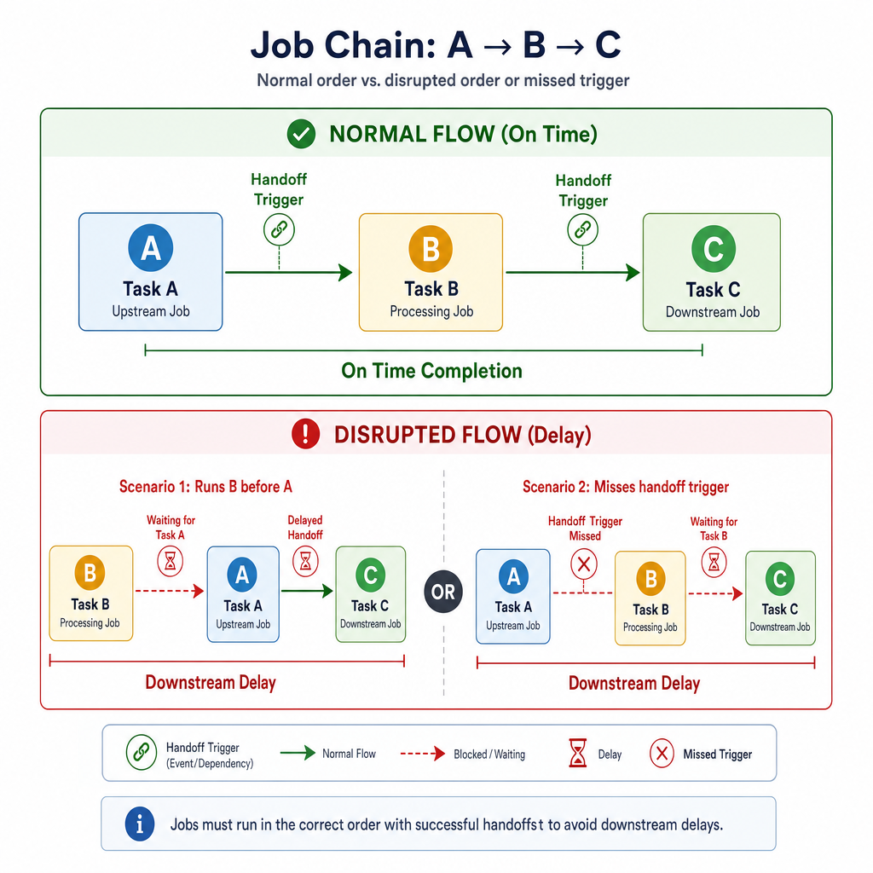
Disrupt Example — Scramble Scheduler Order
Outcome: job chain runs out of sequence
Example: scramble scheduler order
Access: can we edit scheduler state safely?
Chain: upstream and downstream task dependencies?
Timing: wrong order, wrong time, or missed trigger?
Recovery: automatic correction or manual cleanup?
Proof: job logs show broken sequence
Notes:
Say:
"This disrupts coordination, not the whole capability."
"The tasks may all still exist."
"The sequence no longer supports the workflow."
"Scenario: scheduled jobs collect, parse, stage, and forward data in a fixed order."
"Downstream jobs depend on upstream output being ready at the right time."
"Action: change schedule order or trigger timing so jobs run before prerequisites exist."
"Students must map dependencies before changing schedule state."
"Know whether the system self-corrects."
"Manual cleanup means added adversary burden."
"Evidence comes from job logs and delayed downstream action."
Show:
Trace the normal order.
Trace the scrambled order.
Point to the broken handoff.
Do:
Ask: "Which dependency must students prove first?"
Ask: "When would this drift into denial?"
Image Prompt:
A job-chain diagram showing tasks A, B, and C. Normal order is A -> B -> C. The disrupted version runs B before A or misses the handoff trigger, causing downstream delay.

Slide 11
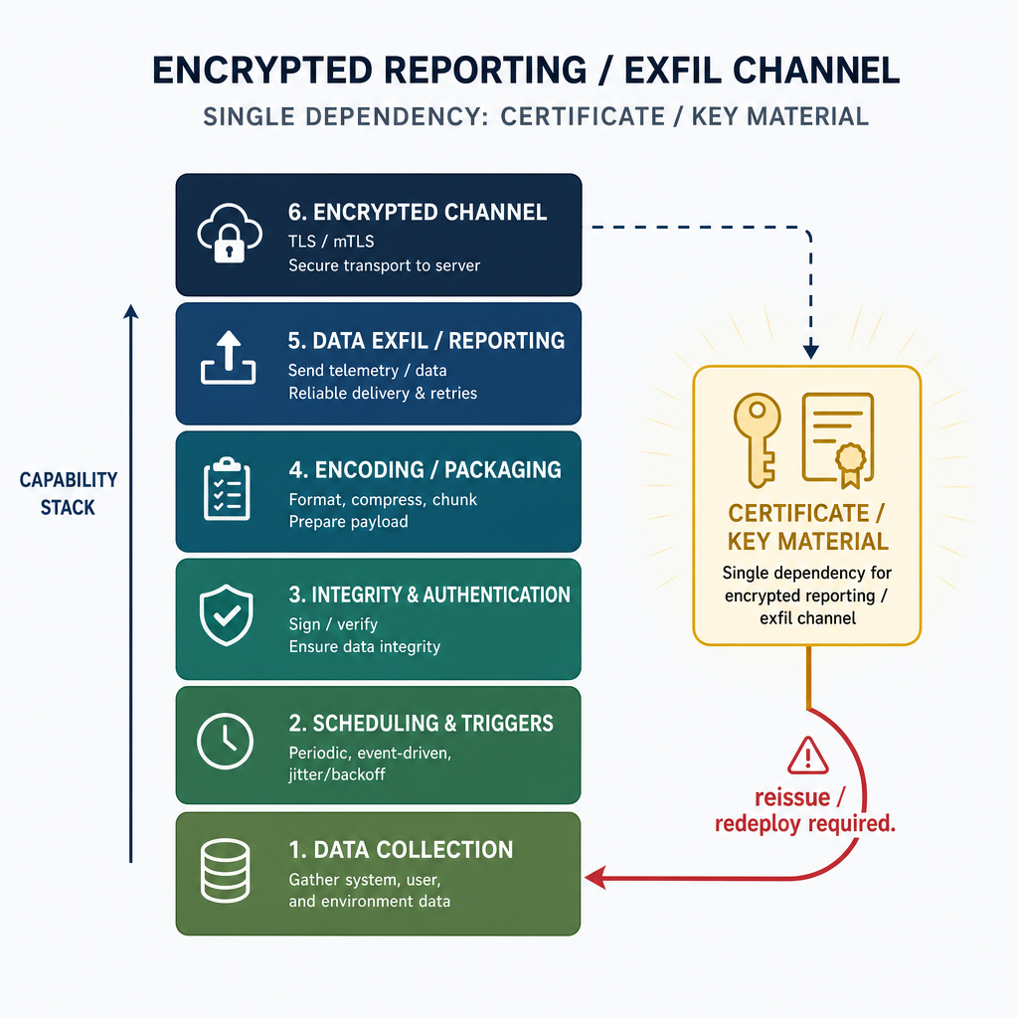
Destroy Example — Remove Key Material
Outcome: secure channel requires rebuild
Example: remove key material
Access: can we reach and verify the key location?
Uniqueness: only working key, cert, or token?
Backups: local copy, vault, snapshot, export?
Authority: mission approval for destructive action?
Proof: failed channel plus rebuild requirement
Notes:
Say:
"Destroy means recovery is hard."
"Here, the destroyed dependency is key material."
"Scenario: the reporting channel depends on one deployed certificate, private key, or token."
"Without that material, the adversary must reissue and redeploy before the channel works."
"Action: remove the required key material and any immediately usable local copy."
"A deleted key only matters if it is unique and required."
"Backups can turn destroy into short disruption."
"This requires explicit mission approval."
"Evidence must show failed channel operation and rebuild burden."
"Do not call it destroy just because a file was deleted."
Show:
Point to the key dependency.
Point to backup checks.
Point to rebuild requirement.
Do:
Ask: "What makes this destructive instead of disruptive?"
Ask: "What backup evidence would change your classification?"
Image Prompt:
A capability stack where certificate/key material is highlighted as the single dependency for an encrypted reporting or exfil channel. Recovery arrow is labeled "reissue / redeploy required."

Slide 12
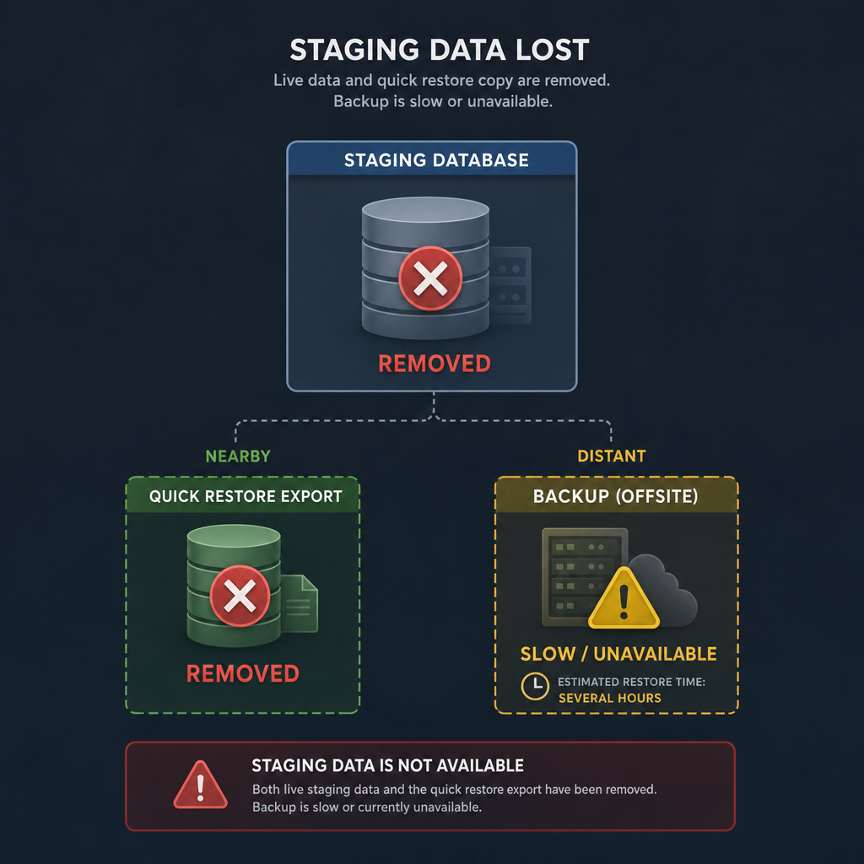
Destroy Example — Wipe Staging Data and Quick Restore Copy
Outcome: staging function needs restoration
Example: wipe staging data plus quick restore copy
Access: can we affect data and local restore copy?
Criticality: does staging data drive the capability?
Containment: avoid unrelated or partner-needed data?
Recovery: distant backup, rebuild, or manual re-entry?
Proof: missing data plus no quick restore path
Notes:
Say:
"This destroys by increasing recovery burden."
"The live data alone may not be enough."
"The quick restore copy matters."
"Scenario: staging data feeds the adversary's analytic or reporting backend."
"A nearby export or snapshot lets them restore quickly if only live data is lost."
"Action: remove the staging data and the quick local restore copy in the same operation."
"Students must avoid unrelated data and partner equities."
"Criticality has to be tied to the adversary capability."
"Evidence is missing staging data plus no quick local restore."
"If ordinary admin steps restore it in minutes, it was not destroy."
Show:
Point to live staging data.
Point to the quick restore copy.
Point to the slower recovery path.
Do:
Ask: "Why does the nearby restore copy matter?"
Ask: "What second-order effects must be checked?"
Image Prompt:
A staging database with a nearby quick restore export. Both the live staging data and quick restore copy are removed, while distant backup is shown as slow or unavailable.

Slide 13
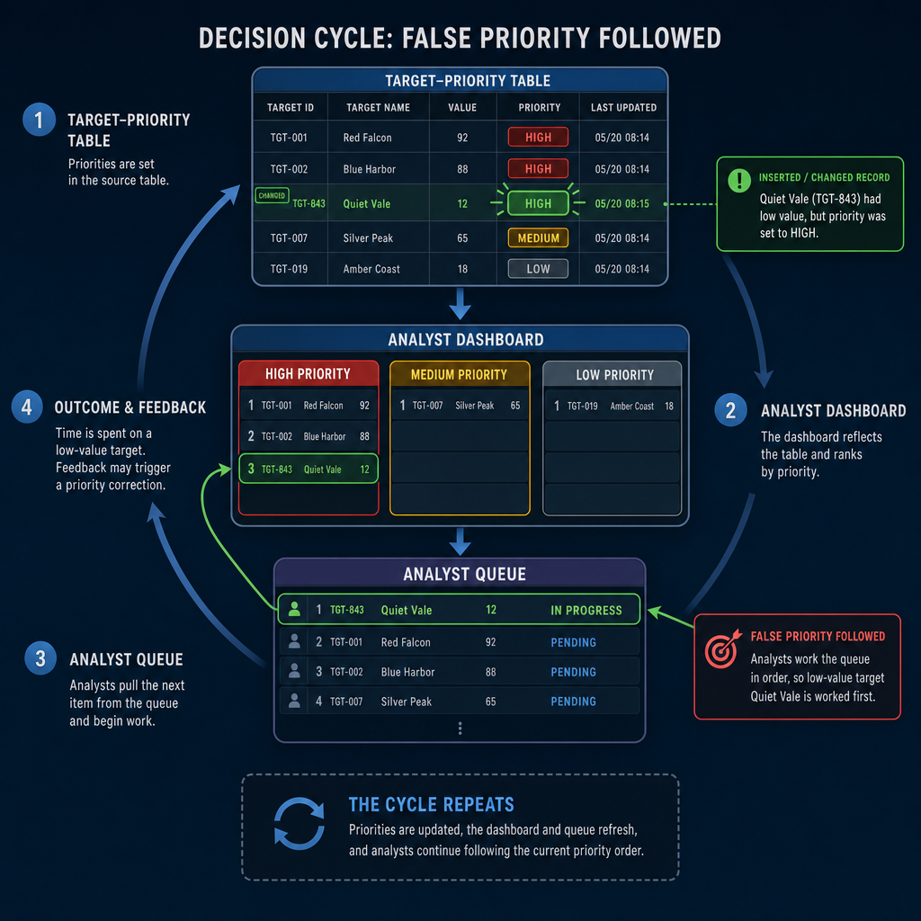
Deceive / Manipulate Example — Poison Target-Priority Records
Outcome: adversary mis-prioritizes effort
Example: poison target-priority records
Access: can we safely write to the right table or queue?
Model: fields, valid values, and downstream consumers?
Believability: consistent host, user, timing, and priority logic?
Detection: can we observe changed tasking or analyst focus?
Proof: poisoned record plus mis-prioritized action
Notes:
Say:
"Deception succeeds when the adversary chooses wrong for a believable reason."
"Scenario: an analyst dashboard ranks targets from a backend priority table."
"Priority fields drive what operators investigate first."
"Action: insert or alter a believable record so the wrong target rises in the queue."
"The goal is mis-prioritization, not outage."
"Check the data model before writing anything."
"Evidence is the poisoned record plus changed analyst focus."
Show:
Point to the priority record.
Point to the dashboard queue.
Point to the wrong high-priority target.
Do:
Ask: "What makes a false priority believable?"
Steer toward field consistency, timing, and existing patterns.
Image Prompt:
A decision-cycle graphic where a target-priority table feeds an analyst dashboard. One inserted or changed priority record moves a low-value target into a high-priority lane, and the analyst queue follows the false priority.

Slide 14
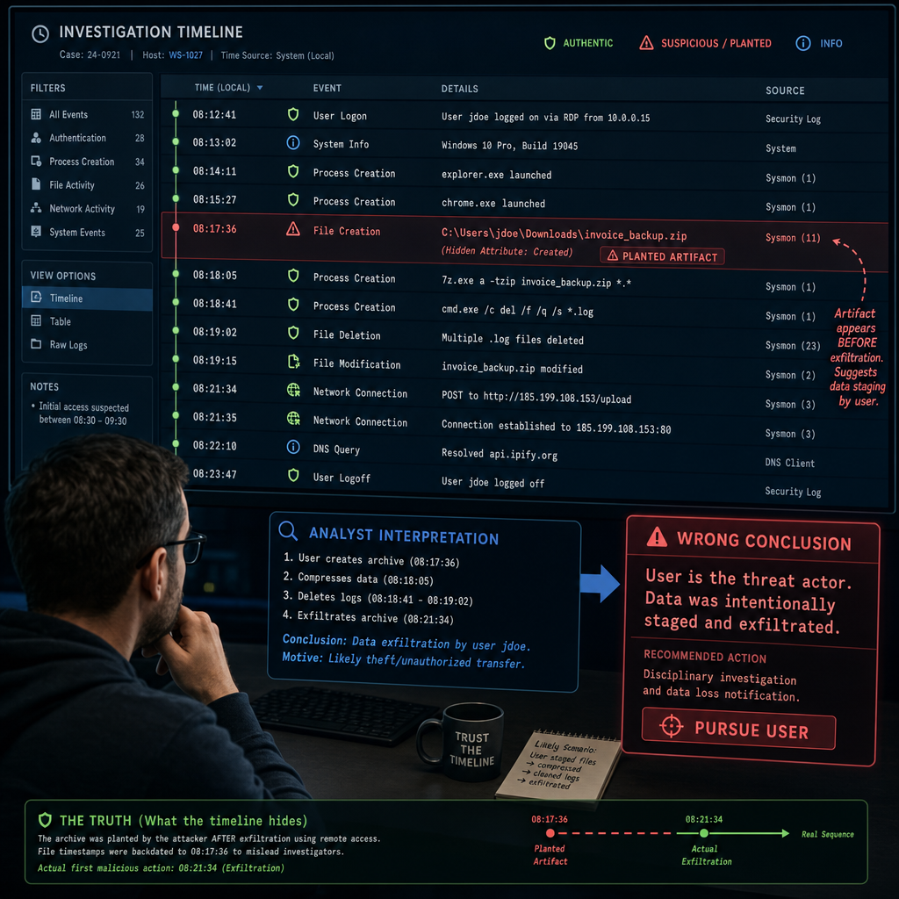
Deceive / Manipulate Example — Plant a False Timeline Artifact
Outcome: adversary trusts the wrong sequence
Example: plant a false timeline artifact
Access: can we place the artifact where analysts already look?
Format: filename, timestamp, metadata, and style match?
Consistency: aligns with other logs and host behavior?
Risk: false artifact does not break normal workflow?
Proof: decoy review, mention, or follow-on action
Notes:
Say:
"This example manipulates the adversary's sense of sequence."
"Scenario: analysts review documents, screenshots, or logs to reconstruct activity."
"They trust artifacts that match normal naming, timing, and metadata."
"Action: place a false timeline artifact in a location they already use."
"The artifact must fit the environment around it."
"If it looks staged, it fails."
"Evidence is decoy review, mention, or follow-on action."
Show:
Point to authentic timeline entries.
Point to the planted artifact.
Point to the wrong conclusion.
Do:
Ask: "What would make this artifact stand out as fake?"
Take two answers.
Image Prompt:
A timeline view with authentic log entries and one planted artifact that shifts the apparent sequence of activity. Analyst attention follows the false timeline toward the wrong conclusion.

Slide 15
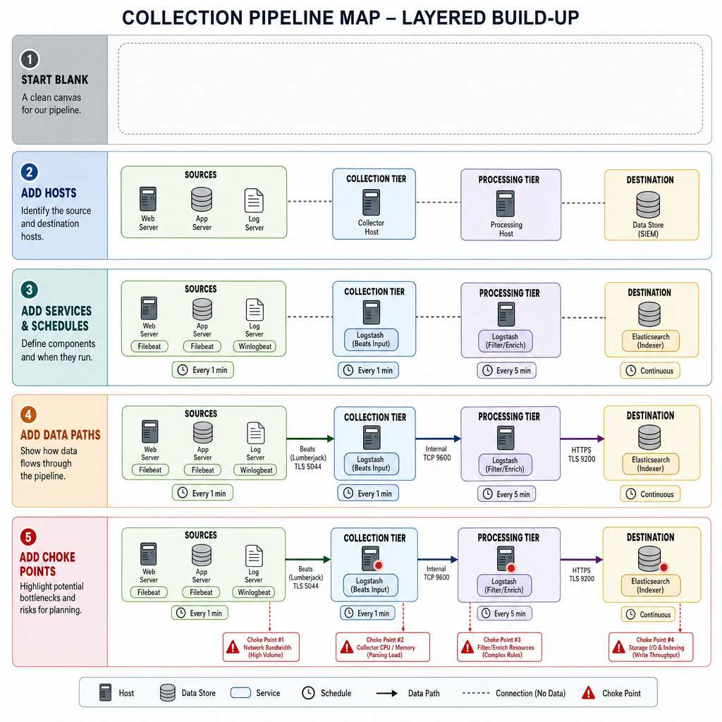
Reconnoiter Example — Map the Collection Pipeline
Outcome: pipeline map changes the next COA
Example: map the collection pipeline
Access: what hosts, services, and data stores are in scope?
Safety: commands are read-only and low-noise?
Unknowns: controller, feeder, parser, database, relay?
Evidence: configs, schedules, process state, and data paths?
Output: diagram-ready facts for COA comparison
Notes:
Say:
"Reconnoiter is an effect when it answers a mission gap."
"Scenario: the team has access but does not know how collection actually flows."
"The pipeline may include feeders, parser jobs, staging storage, and reporting relays."
"Action: enumerate services, schedules, configs, data paths, and process state."
"The result should support COA comparison."
"Use read-only, low-noise collection first."
"Evidence is a pipeline map tied to real artifacts."
Show:
Build the map layer by layer.
Point to newly discovered dependencies.
Point to the likely choke point.
Do:
Ask: "What fact would change your next COA?"
Take one or two answers.
Image Prompt:
A layered pipeline map that starts blank, then adds hosts, services, schedules, data paths, and choke points until the collection workflow is clear enough for planning.

Slide 16
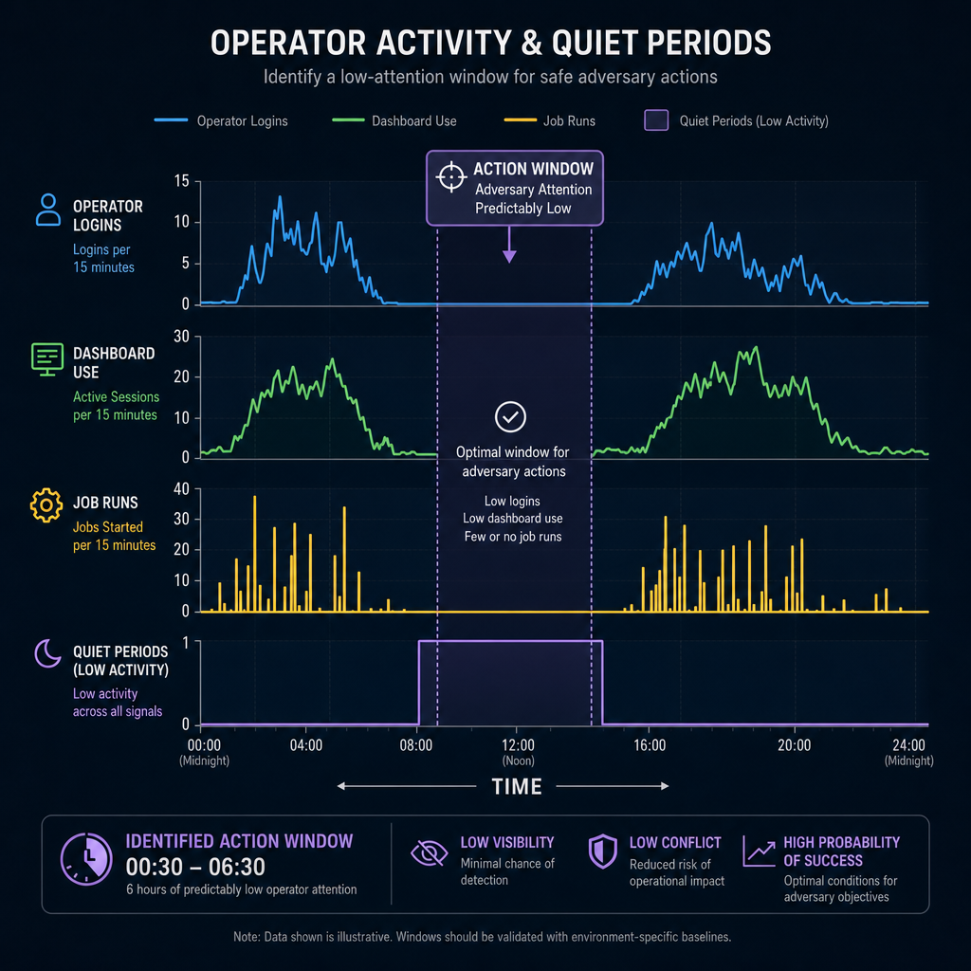
Reconnoiter Example — Confirm Operator Cadence
Outcome: timing intelligence changes action window
Example: confirm operator cadence
Access: can we inspect logs without changing state?
Sources: login history, job logs, dashboard events, edits?
Time basis: timezone, clock drift, and log rollover?
Attribution: human operator, service account, or automation?
Proof: cadence pattern tied to next action timing
Notes:
Say:
"This recon example is about timing."
"Scenario: stronger effects depend on when adversary operators are active or absent."
"Logs may show login patterns, dashboard touches, task edits, or review cycles."
"Action: compare multiple time sources to establish operator cadence."
"Do not trust one timestamp without checking time basis."
"Separate human activity from automation."
"Evidence is a cadence pattern that changes when you act."
Show:
Point to active periods.
Point to quiet periods.
Point to the proposed action window.
Do:
Ask: "Why is timezone or clock drift a mission issue here?"
Ask: "What source would corroborate operator activity?"
Image Prompt:
A time-series graphic showing operator logins, dashboard use, job runs, and quiet periods. A highlighted action window appears where adversary attention is predictably low.

Slide 17
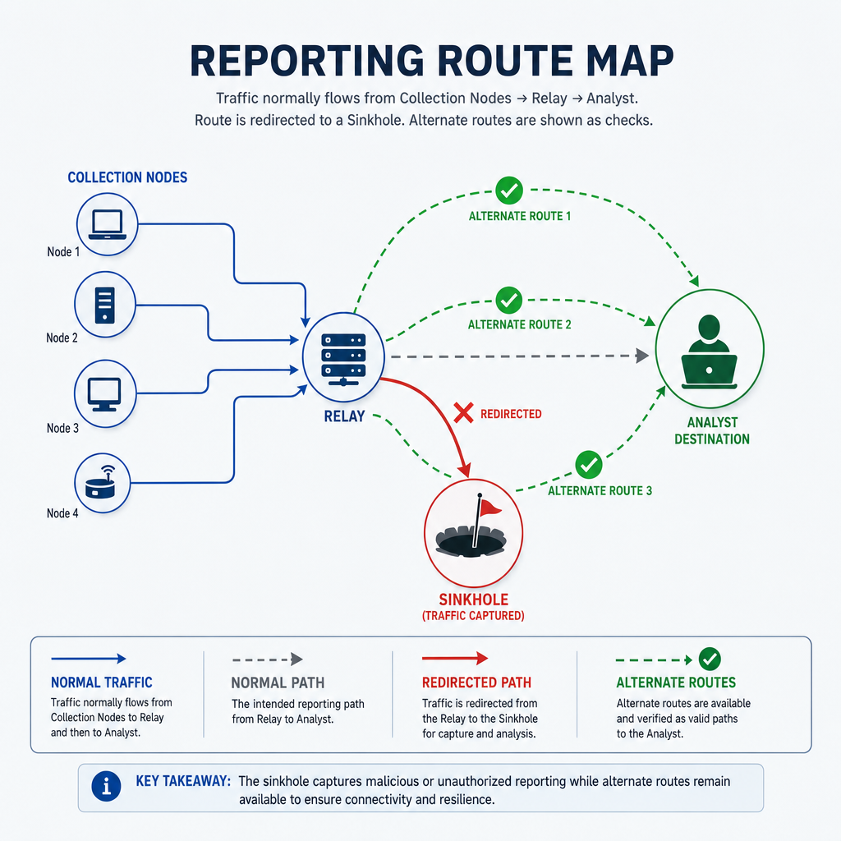
Interdict Example — Sinkhole the Reporting Destination
Outcome: reporting path ends at a sink
Example: sinkhole the reporting destination
Access: can we change DNS, proxy, or routing control?
Path: destination name, address, protocol, and relay path?
Scope: affects intended reporting flow only?
Alternates: cached address, backup domain, direct IP path?
Proof: traffic reaches sink or fails before analyst node
Notes:
Say:
"Interdict is pathway language."
"Scenario: collected data reaches analysts through a named reporting destination."
"The destination depends on DNS, proxy, or route resolution."
"Action: sinkhole or redirect that destination so reporting never reaches the analyst node."
"The endpoint tool may still run."
"The path no longer delivers useful movement."
"Evidence is sinkhole traffic or failed delivery before the analyst node."
Show:
Trace normal reporting path.
Point to the sinkhole point.
Point to alternate-route checks.
Do:
Ask: "Why is this interdict instead of local denial?"
Make students answer in pathway terms.
Image Prompt:
A reporting route map where traffic normally moves from collection nodes through a relay to an analyst destination. The route is redirected to a sinkhole, with alternate routes shown as checks.

Slide 18
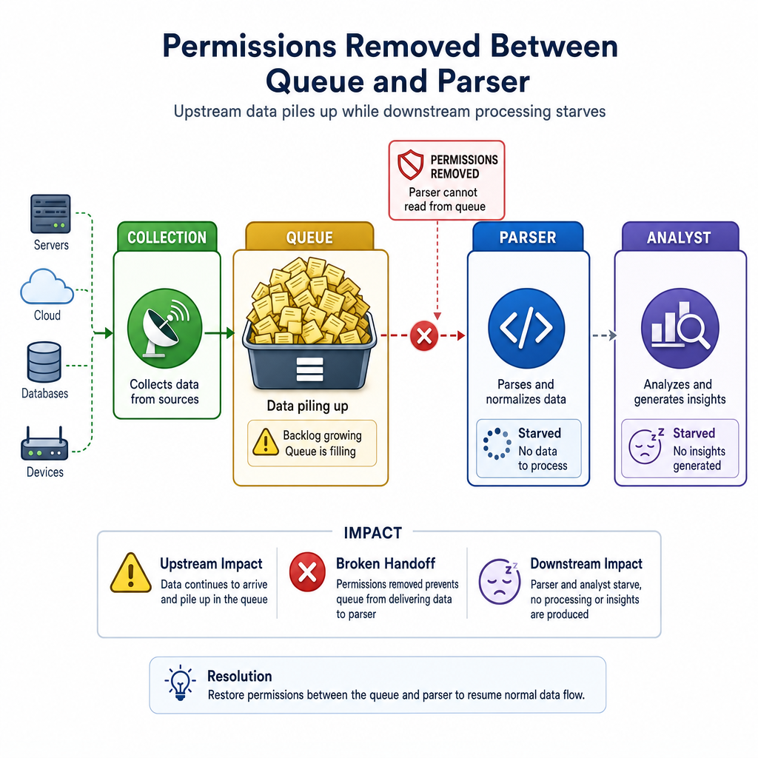
Interdict Example — Remove Queue Access Between Stages
Outcome: workflow segment is isolated
Example: remove queue access between stages
Access: can we change queue or share permissions?
Handoff: which stage writes and which stage reads?
Impact: upstream collection continues but cannot advance?
Containment: only intended queue, share, or API endpoint?
Proof: stalled queue plus isolated downstream stage
Notes:
Say:
"This interdicts the handoff point."
"Scenario: one stage drops data into a queue, share, or API endpoint."
"A downstream stage reads from that handoff point and continues processing."
"Action: remove or narrow access so the downstream stage cannot receive the handoff."
"Upstream collection may still run."
"The pathway between stages is cut."
"Evidence is stalled queue growth and downstream starvation."
Show:
Point to upstream collection.
Point to the handoff queue.
Point to isolated downstream stage.
Do:
Ask: "What must students prove before changing permissions?"
Ask: "What would show endpoint failure instead of pathway interdiction?"
Image Prompt:
A workflow diagram with collection, queue, parser, and analyst stages. Permissions are removed between the queue and parser, so upstream data piles up while downstream processing starves.

Slide 19
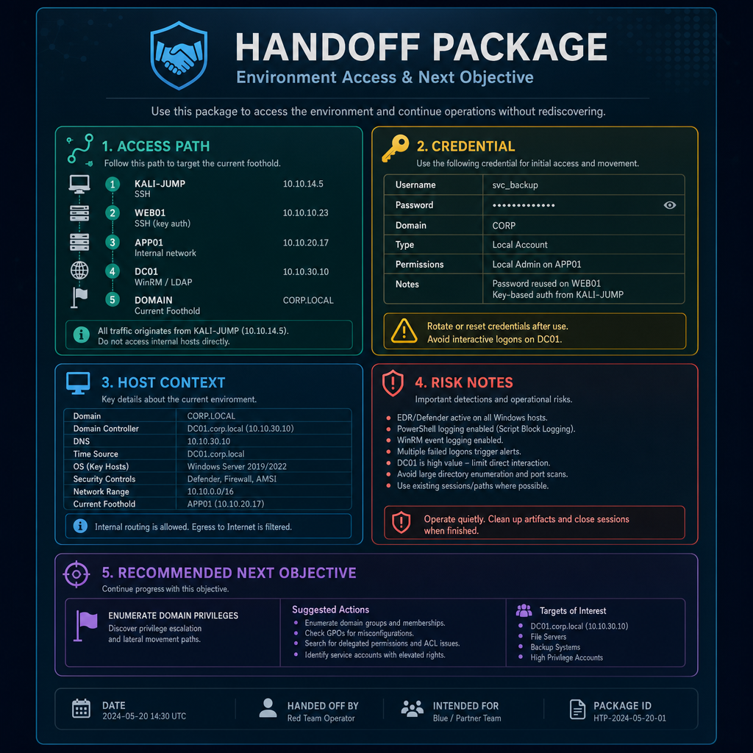
Handoff Example — Deliver an Access Package
Outcome: partner can use access immediately
Example: deliver an access package
Access: tested path, account, credential, and method?
Context: host role, network position, privileges, limits?
Reliability: session lifetime, resets, MFA, timing windows?
Risk: deconfliction, burn risk, and do-not-touch notes?
Proof: partner can connect and orient in minutes
Notes:
Say:
"Handoff's outcome is partner reach."
"Scenario: your team has tactical access that another team needs to continue the mission."
"The partner cannot afford to rediscover the environment."
"Action: deliver a concise access package with connection method, credential, host context, limits, and risk notes."
"The package must be usable in the first few minutes."
"Include what not to touch."
"Evidence is the partner connecting and orienting from your report."
Show:
Walk the package fields.
Point to first-five-minutes usability.
Point to risk notes.
Do:
Ask: "What would make this package unusable?"
Build a short list live.
Image Prompt:
A handoff package with access path, credential, host context, risk notes, and recommended next objective. The partner team uses the package to connect without rediscovering the environment.

Slide 20
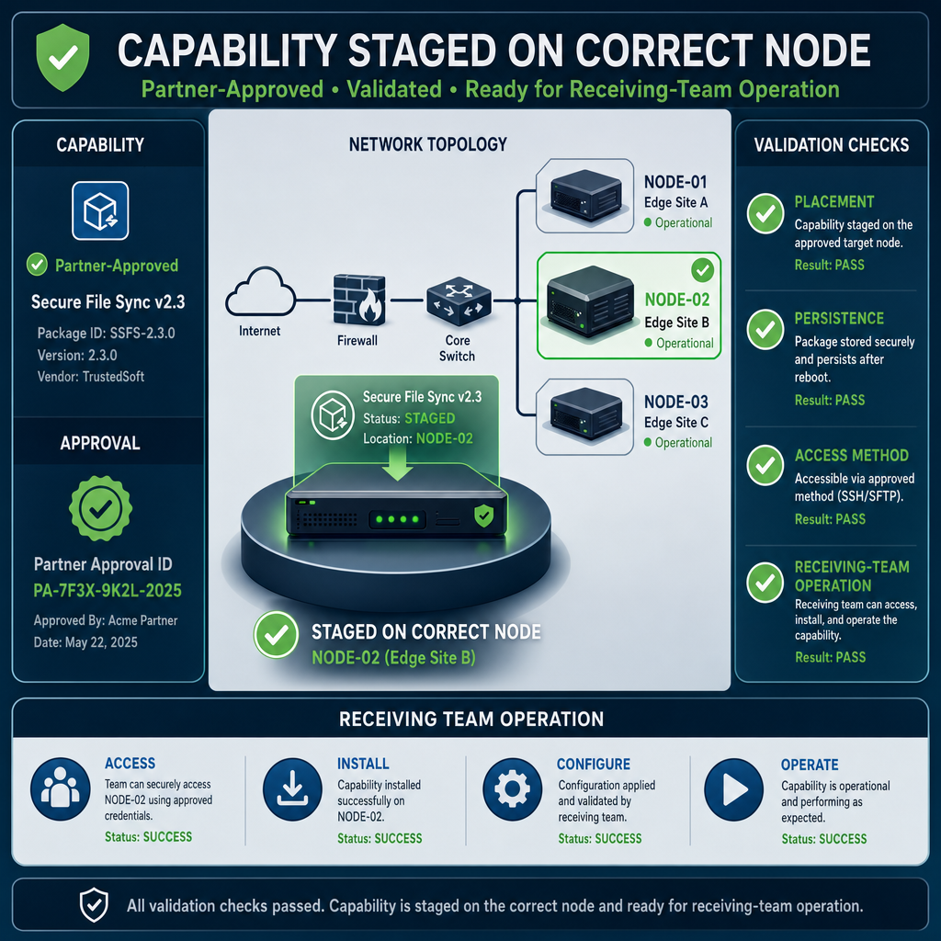
Handoff Example — Validate a Partner Capability
Outcome: partner capability is ready to operate
Example: validate a partner capability
Approval: capability, placement, and timing are authorized?
Node: correct host, privilege level, and network position?
Persistence: survives reboot, task rotation, or session loss?
Training: receiving team knows use, limits, and recovery?
Proof: partner can operate capability from handoff notes
Notes:
Say:
"This handoff is more than reporting access."
"Scenario: a partner-approved capability must be placed or validated on the right node."
"The partner needs confidence that it works and will still be there when they take over."
"Action: validate placement, access method, persistence behavior, and operating notes."
"Do not improvise unapproved tools."
"Training and limits are part of the handoff."
"Evidence is the partner operating from your notes without rediscovery."
Show:
Point to the placement node.
Point to persistence checks.
Point to partner operating notes.
Do:
Ask: "What must be validated before the partner accepts this?"
Ask: "What would burn the handoff?"
Image Prompt:
A partner-approved capability staged on the correct node with validation checks for placement, persistence, access method, and receiving-team operation.

Slide 21
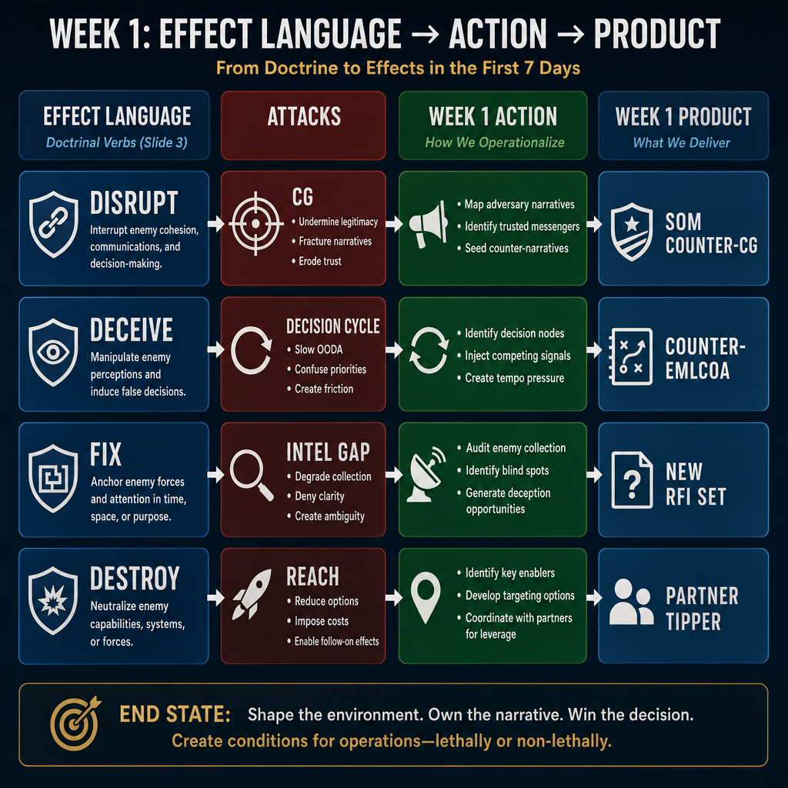
Mapping Effects to Week 1 Vocabulary
D4M / interdict: CG as capability or pathway
Deceive / manipulate: decision cycle and EMLCOA
Reconnoiter: RFIs, assumptions, refined CV
Handoff: partner reach and operational options
Week 1 intent still applies: impose cost; generate options
Notes:
Say:
"This is how you justify the effect."
"D4M and interdict often attack CG as capability or pathway."
"Deceive and manipulate attack decision cycle and EMLCOA."
"Reconnoiter closes intelligence gaps and refines the next COA."
"Handoff converts tactical success into operational reach."
"Your answer to the commander should sound like Week 1 planning."
"Every effect decision is a planning decision."
Show:
Walk the four lanes left to right.
Tie each effect family to its Week 1 product.
Do:
Return to the APT example from Slide 1.
Assign one effect family to each student pair.
Give two minutes for Week 1 justification.
Take one example back.
Image Prompt:
A four-lane mapping graphic. Left lane labeled "Effect language" with the doctrinal verbs from Slide 3. Middle lane labeled "Attacks" (CG / Decision cycle / Intel gap / Reach). Right lane labeled "Week 1 Product" (SOM counter-CG, counter-EMLCOA, new RFI set, partner tipper).

Slide 22
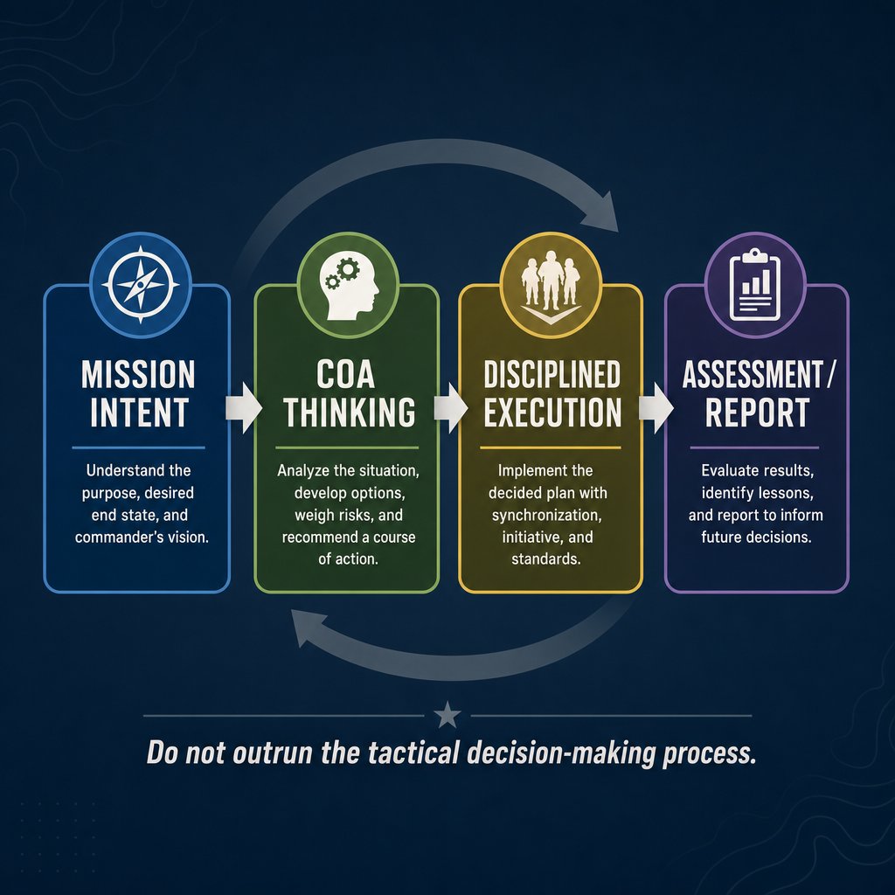
Professional Operations Under Command Direction
Command-directed operations
Not hacking just to hack
Access is only one condition
Think through the full tactical process
Then execute, assess, and report
Notes:
Say:
"This course does not teach random hacking."
"It trains command-directed effects operations."
"Access is only one condition for action."
"Reachability is not permission to start typing."
"First: restate mission, desired effect, candidate actions, adversary response, team coordination, and success evidence."
"Then: execute."
"This is the bridge to the Week 1 tactical decision-making process."
Show:
Point to "Mission Intent."
Point to "COA Thinking."
Point to "Disciplined Execution."
Emphasize thinking before execution.
Do:
Ask: "What is the risk of hacking first and planning afterward?"
Take two answers.
Steer toward wrong effect, burned access, poor deconfliction, and unusable reporting.
Image Prompt:
A professional operations graphic with four linked blocks: "Mission Intent," "COA Thinking," "Disciplined Execution," and "Assessment / Report." Underneath, a short caption: "Do not outrun the tactical decision-making process."

Slide 23
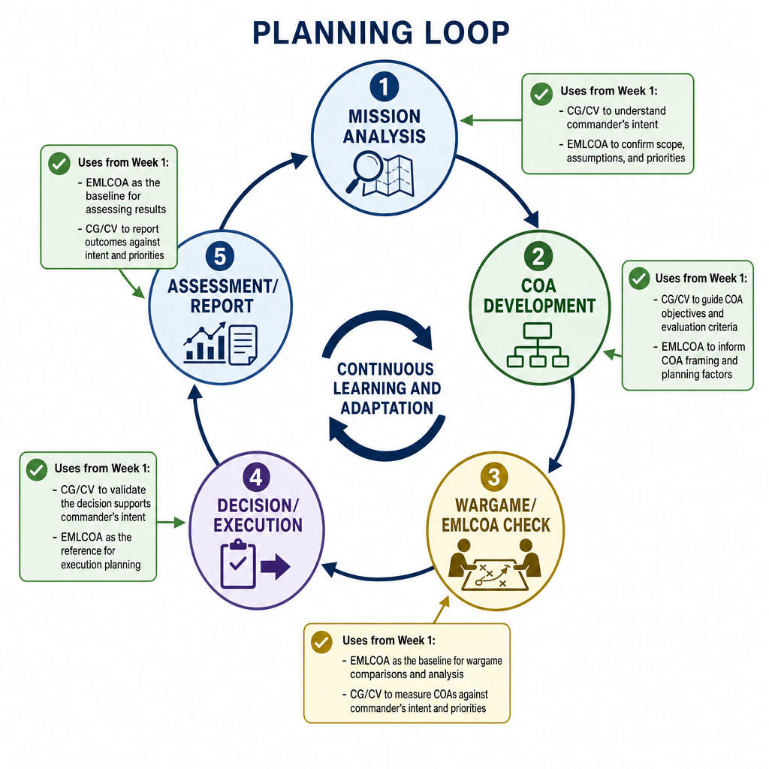
Counterstrike Planning Cycle (Week 1 Applied)
Same Week 1 flow
Mission analysis: task / purpose / constraints / desired effect
COA comparison: feasible / acceptable / suitable / adversary response
Execution: select / coordinate / act
Assessment: intended effect vs observed effect
Notes:
Say:
"Apply Week 1 discipline to every keyboard action."
"First: define mission and desired effect."
"Then: build and compare COAs."
"Include likely adversary response."
"Select and coordinate one COA."
"Execute, assess intended versus observed effect, and report in commander language."
"The technical command is the last step, not the first."
Show:
Walk the planning loop clockwise.
Tie each node to Week 1 products.
Do:
Scenario: "Task: deny adversary collection for one reporting period."
Students verbalize mission analysis, candidate COA, anticipated adversary response, and assessment criterion.
Image Prompt:
A planning loop diagram with five nodes: "Mission Analysis," "COA Development," "Wargame/EMLCOA Check," "Decision/Execution," and "Assessment/Report." Add small callouts showing where CG/CV and EMLCOA from Week 1 are used.

Slide 24
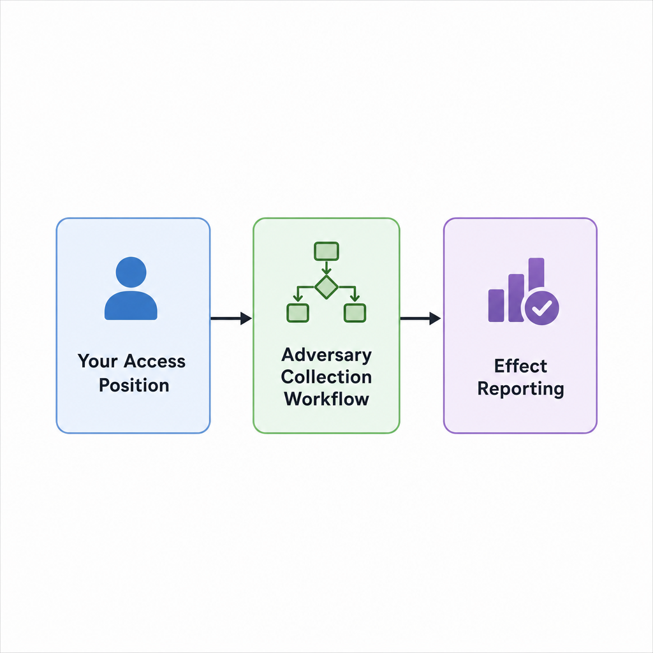
Today's Two Labs — L4.1a and L4.1b
L4.1a: disable adversary tooling
Effects: degrade / disrupt / deny
L4.1b: false information injection
Effects: deceive / manipulate
Deliverable: short effect report
Notes:
Say:
"Two labs today."
"Same operational problem set."
"Different effects."
"L4.1a: collection-focused; choose degrade, disrupt, or deny where reversible paths are preferred."
"L4.1b: decision-cycle-focused; deceive or manipulate without producing an outage."
"Each lab produces a short effect report: effect, action, observed result, risk assessment."
"Platform details live in the student briefs."
Show:
Show the generic operation flow.
Keep attention on access, workflow, and reporting.
Do:
Hand out the L4.1a student brief.
Remind students the brief is the authority document.
Break for 15 minutes, then begin the lab.
Image Prompt:
A generic operation flow diagram with three boxes: "Your Access Position," "Adversary Collection Workflow," and "Effect Reporting." Do not include platform or infrastructure implementation details.

Slide 25
Wrap — Planning Cadence, Then Execute
Before action: effect / action / predicted response
After action: observed result / risk reassessment
Five lines = report format
Tomorrow: Reconnoiter and Handoff
Notes:
Say:
"Five lines."
"Effect, action, predicted response, observed result, risk reassessment."
"That is your report."
"It is short on purpose; commanders read five lines."
"First three lines happen before keyboard action."
"Last two lines prove whether the intended effect occurred and whether risk changed."
"If the action cannot survive five-line reporting, reconsider it."
Show:
Show the five-line cadence verbatim.
Do:
Students write the blank template in their notebook.
They fill it in twice today and twice tomorrow.
Release to L4.1a.
Image Prompt:
No image required for this slide.

Slide 26
Questions?

